Slide 1


PROTECT AMERICA | DEPENDABLE SECURITY FOR EVERY HOME
The Protect America Opportunity

Slide 2
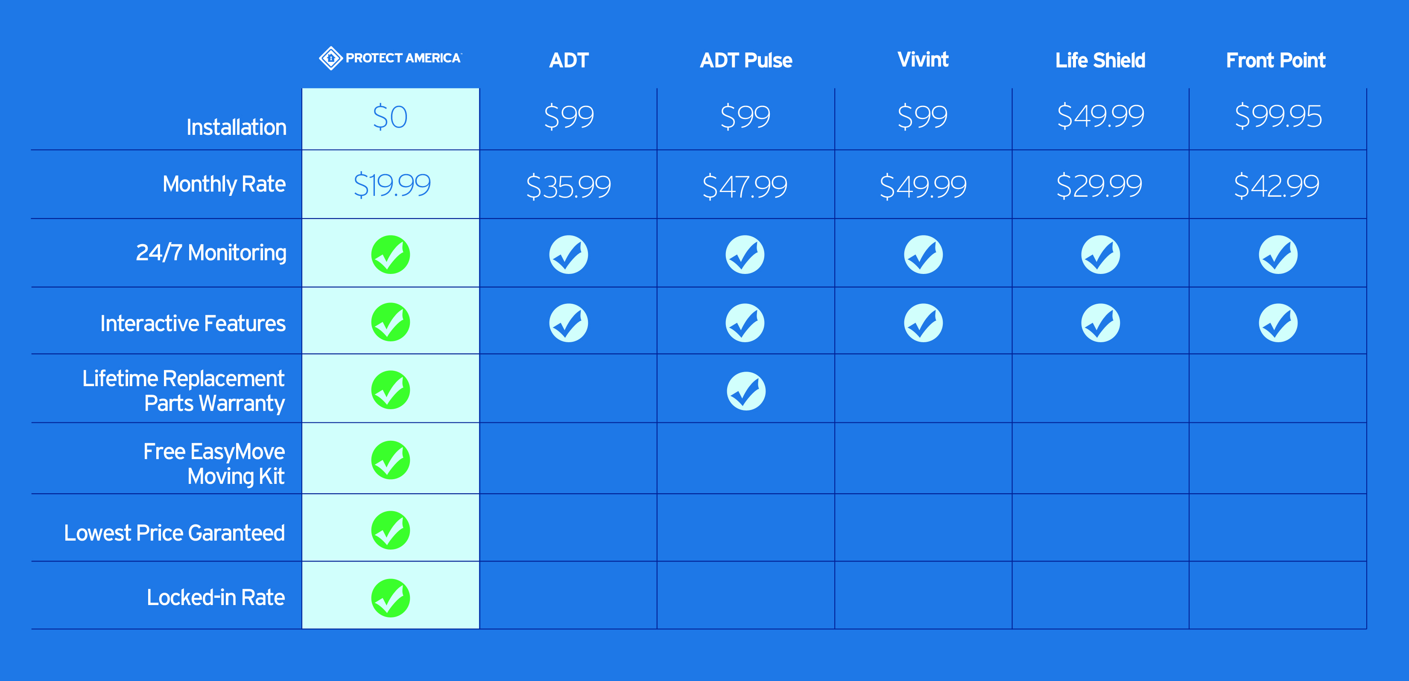
PROTECT AMERICA – CAPABILITIES

Slide 3

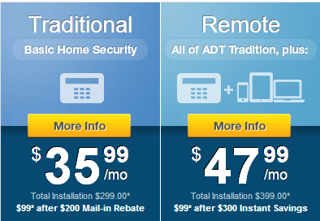
BAIT AND SWITCH
TRADITIONAL
HARDWIRED
THIS SYSTEM IS $99 AFTER A $200 MAIL IN REBATE
REMOTE
WIRELESS
DOES NOT INCLUDE ONE TIME ACTIVATION FEE
INSTANT SAVINGS ONLY VALID FROM MIN. $49.99 PER MONTH AND NOT THE ADVERTISED $47.99

Slide 4
BAIT AND SWITCH
PACKAGE INCLUDES:
1 KEYPAD
2 DOOR AND WINDOW SENSORS
1 MOTION DETECTOR
1 KEYCHAIN REMOTE CONTROL
ACTUAL
REMOTE ONLY COMES WITH ADT QUICKCONNECT PLUS*
TOTAL MONITORING FEE W/ QSP $47.99
TOTAL INSTALLATION : $399.00
$99 AFTER $300 INSTANT SAVINGS

Slide 5
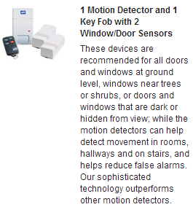
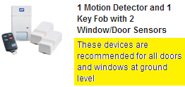
THE SWITCH
ADT RECOMMENDS THAT YOU COVER ALL OF YOUR DOORS AND WINDOWS
THEY START YOU OFF WITH A BASIC SECURITY PACKAGE THEN TRY TO UPSELL YOU

Slide 6

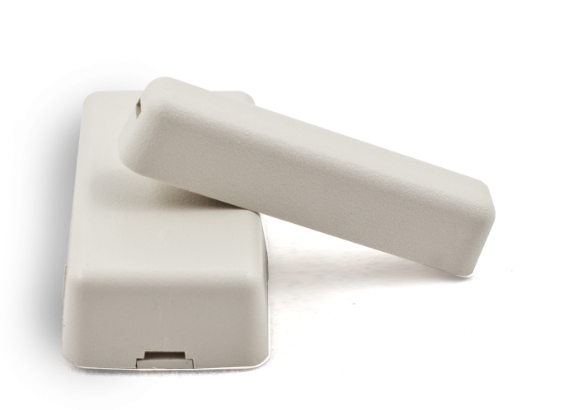
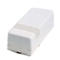
PROTECT AMERICA VS. ADT
DOOR/WINDOW SENSOR
$39.50
DOOR/WINDOW SENSOR INSTALLATION
$80.00

Slide 7
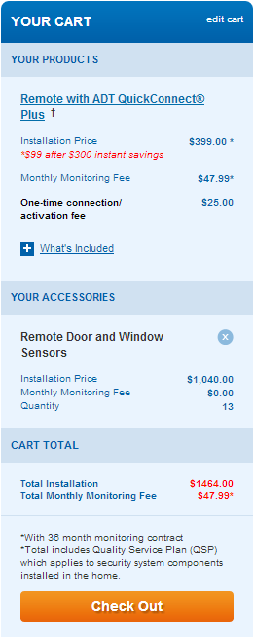
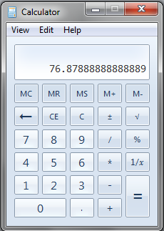
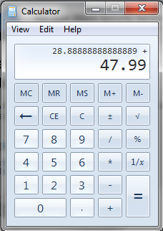
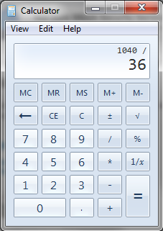
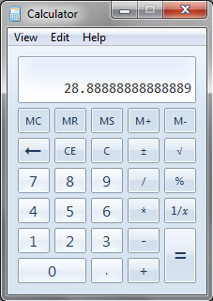
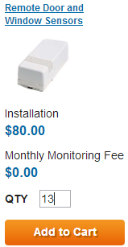
WHAT ARE YOU REALLY GETTING?
RECAP
$399 UPFRONT
$47.99 PER
$1040 ADDITIONAL EQUIP
$1464 UPFRONT COST

Slide 8
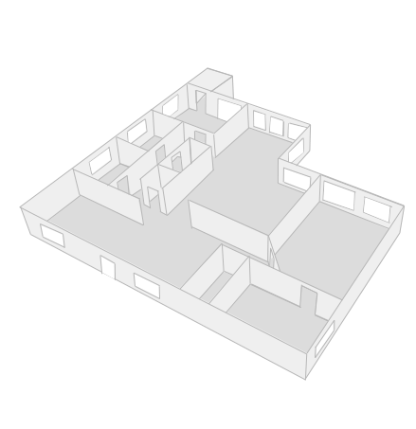

VULNERABILITY
RESULT: NO FULL PROTECTION. INCREASE POSSIBILITY OF BREAK IN.

Slide 9
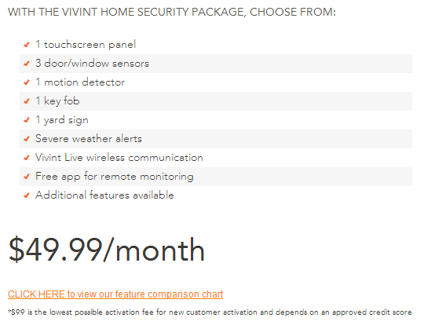
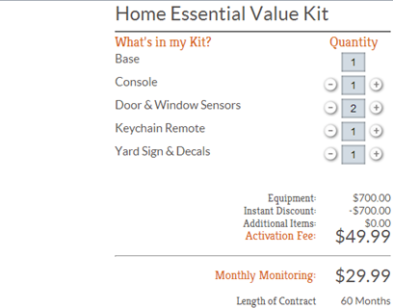


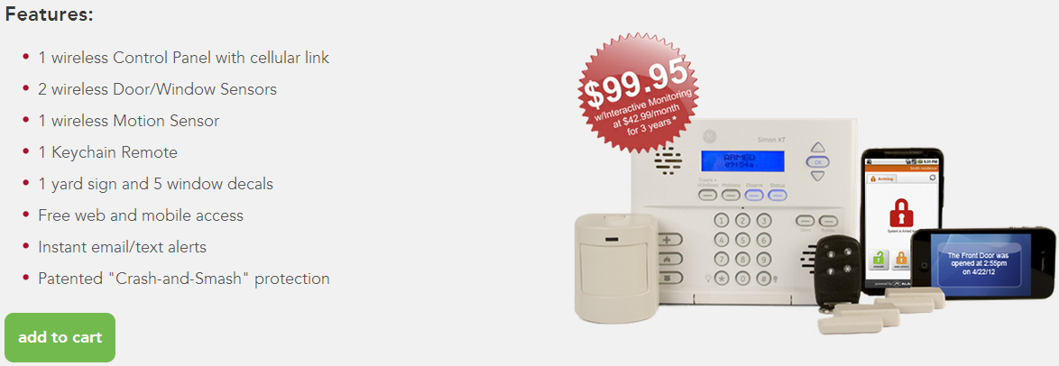


Slide 10
OTHER COMPETITORS
VIVINT
FRONTPOINT
$99 ACTIVATION/INSTALLATION
3 DOOR/WINDOW SENSORS
1 MOTION DETECTOR
$49.99/MO
$99.99 ACTIVATION/INSTALLATION
2 DOOR/WINDOW SENSORS
1 MOTION DETECTOR
$29.99/MO
LIFESHIELD
BASIC PROTECTION
UPFRONT EQUIPMENT CHARGES
PREMIUM SECURITY PRICING
$49.99 ACTIVATION/INSTALLATION
2 DOOR/WINDOW SENSORS
1 MOTION DETECTOR
$29.99/MO
60 MO. CONTRACT

Slide 11
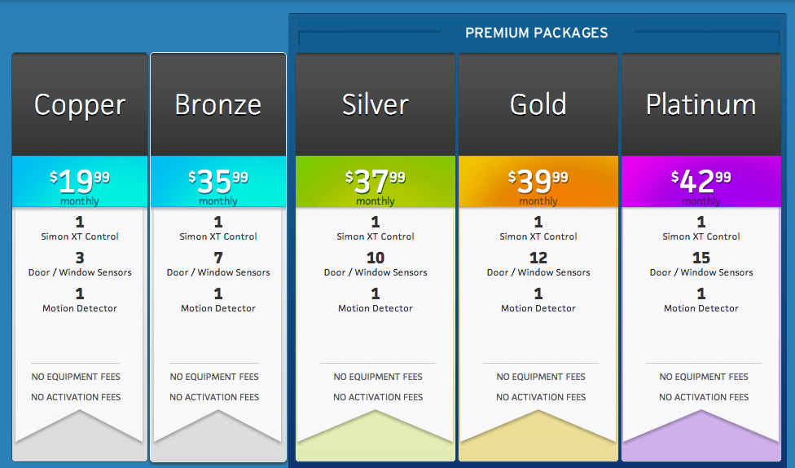
THE PROTECT AMERICA ADVANTAGE
STRAIGHT FORWARD PRICING
NO EQUIPMENT FEES
NO ACTIVATION FEES

Slide 12
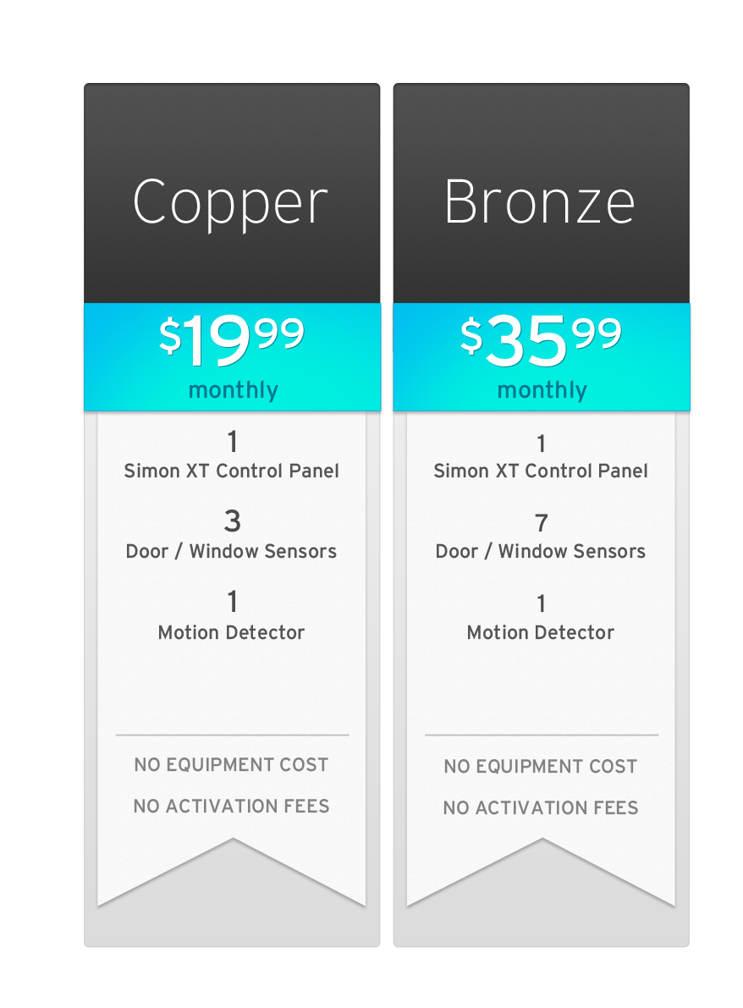
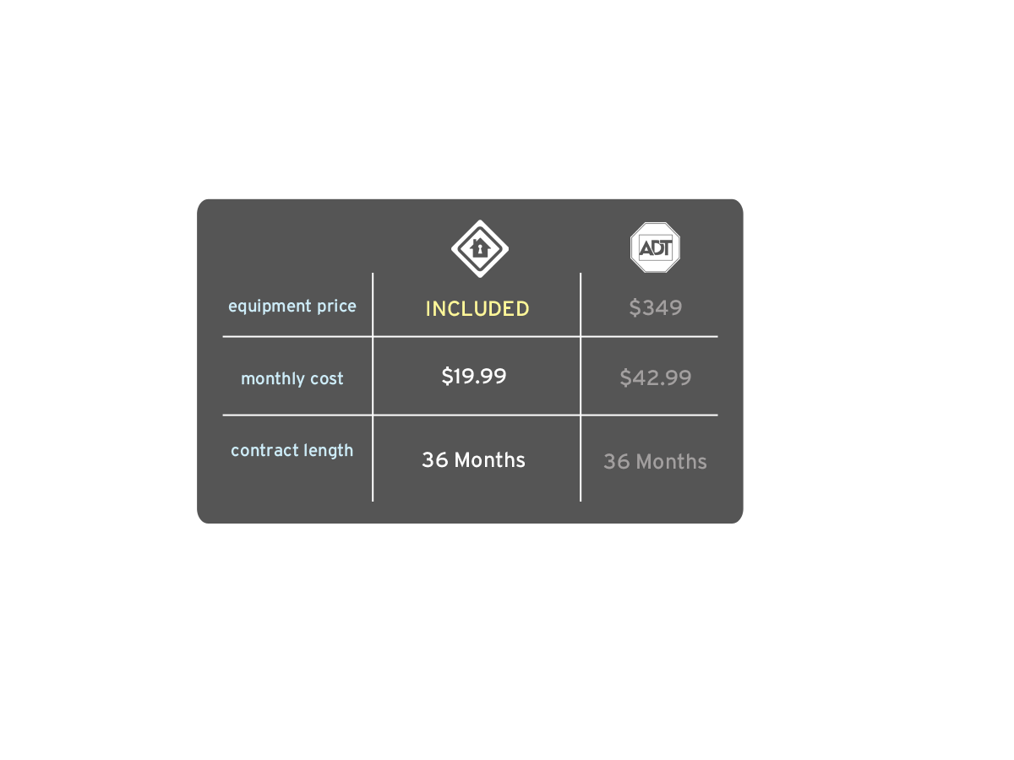
THE PROTECT AMERICA ADVANTAGE
BASIC PROTECTION
PROTECTION FOR SMALL HOMES
APARTMENTS

Slide 13
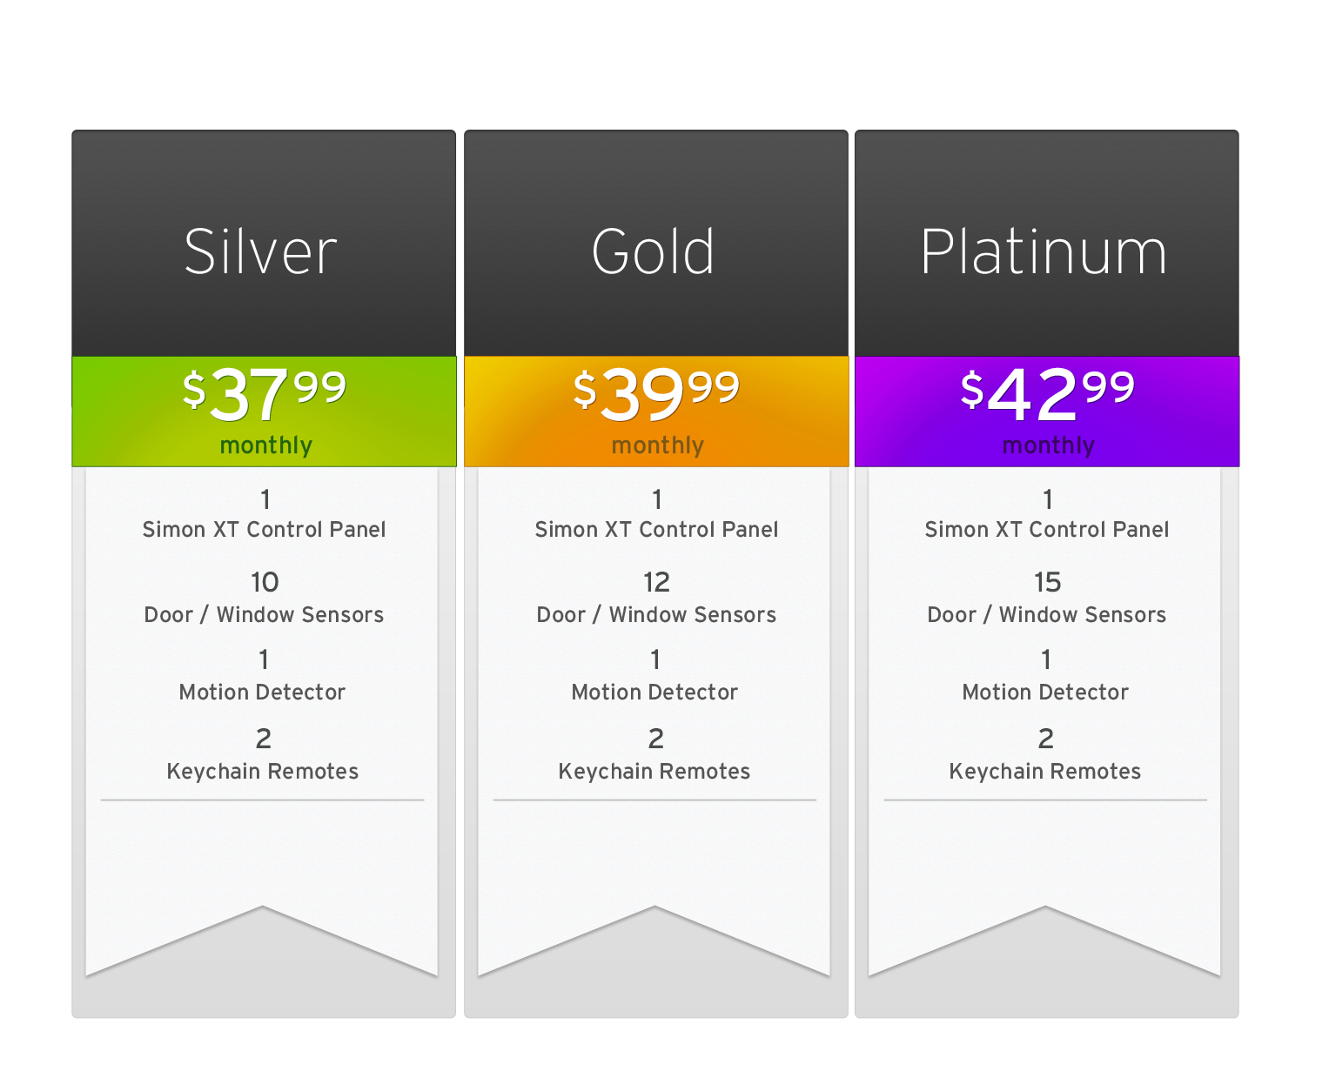
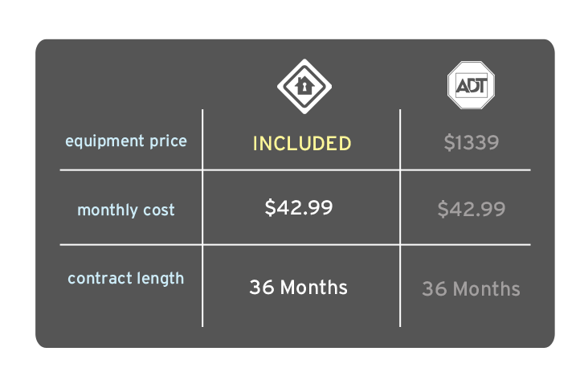
THE PROTECT AMERICA ADVANTAGE
PREMIUM PROTECTION
PROTECTION FOR WHOLE HOME

Slide 14
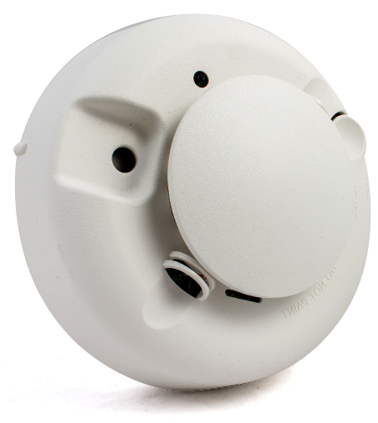
PROTECT AMERICA — FULLY CUSTOMIZABLE PACKAGES
TRULY CUSTOMIZABLE
POINT SYSTEM ALLOWS EQUIPMENT SWAP
SAVES UPFRONT MONEY
3 DOOR AND WINDOW SENSORS = 1 SMOKE DETECTOR
DOOR/WINDOW SENSOR
5PTS
SMOKE DETECTOR
15PTS

Slide 15
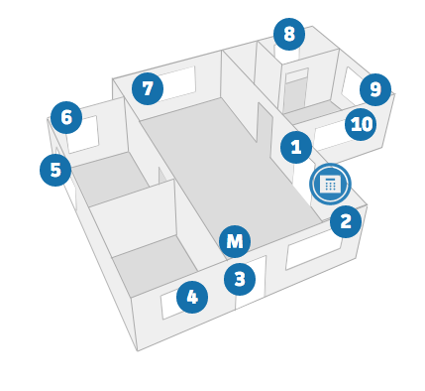
FULL HOME PROTECTION
RESULT: FULL HOME PROTECTION. DETERES BURGLARS

Slide 16
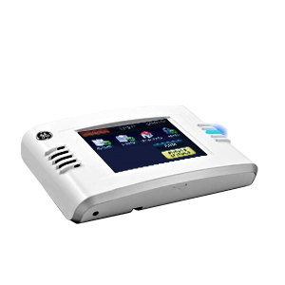
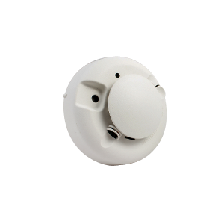
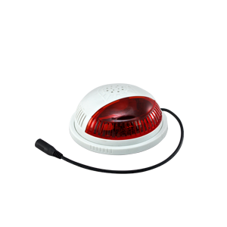
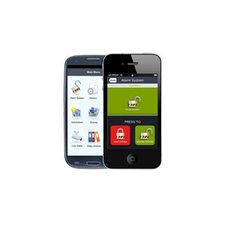
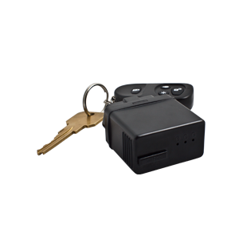





PROTECT AMERICA – WHY BUY?
Top rated DIY provider
Affordable Lifetime monthly rates
Lifetime equipment warranties
No Equipment costs
Technology – wireless, mobile, DIY, GPS, cameras, automation
No installation appointments – drilling or tools required
Guided installation process lead by Protect America
Seven Day Price-Match Guarantee
HOME SECURITY
LIFE SAFETY
AUTOMATION
SMART CONNECT
GPS

